Slide 1
Epidemic prevention measures for confirmed cases in the dormitory
KMU OSA

Slide 2
When someone get positive result for rapid test in the room
For residents who are positive for rapid test and their roommates
Please notify the dorm leaders, dorm manager, mentors and Division of Health Service (during office hours) or the Campus Security Center (night time and holidays), and fill out the school’s COVID-19 case self-report questionnaire.
Take the initiative to PM the dormitory fan page KMUDormbook on FB, informing your basic information (Dorm + room/bed number + student ID + name), identity (confirmed case/confirmed case's roommate), and current location.
Follow the instructions of the dorm leaders/manager to move with the epidemic prevention route.

Slide 3
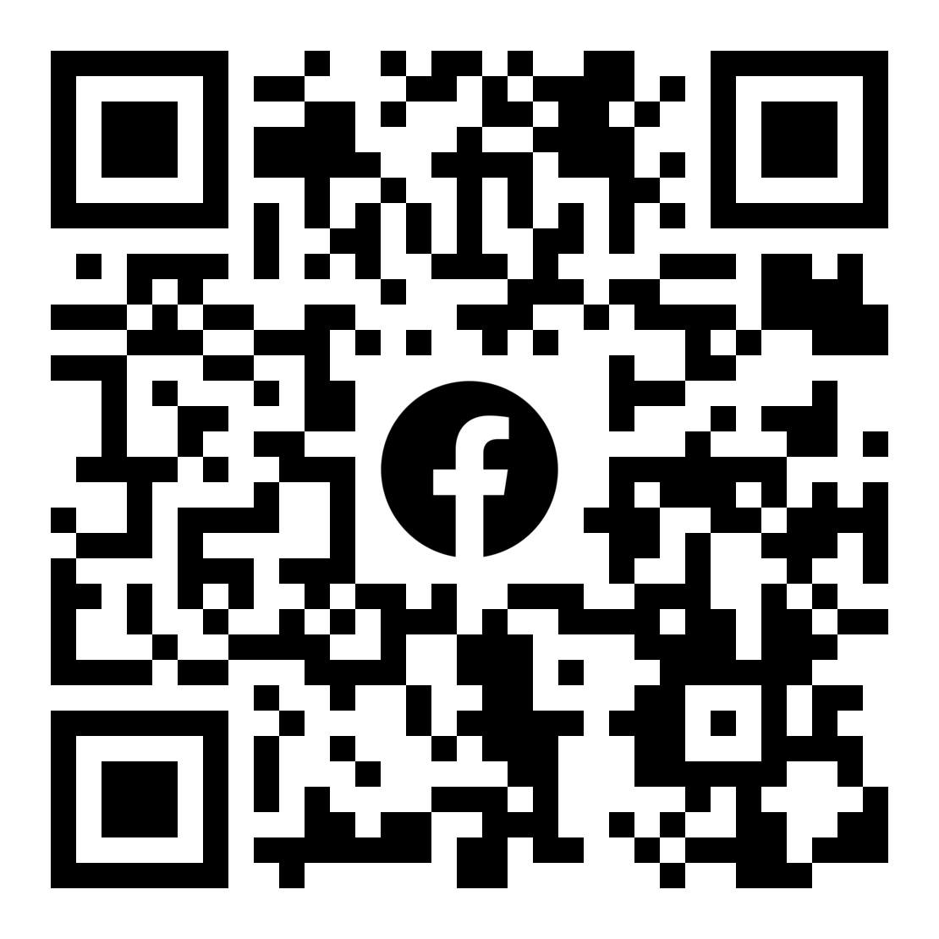
KMUDormbook
PM
Contact

Slide 4
Positive result should be evaluated by a doctor
If your result of rapid test is positive, please write your name and the date of collection on the reagent, seal the reagent, and take it to a clinic by a taxi or non- mass transit for medical treatment and take the medicines according to the symptoms.

Slide 5
quarantine days for the roommates of a confirmed case
Roommates (close contacts) who have not taken three doses of the vaccine will need to take a three-day home quarantine + four-day self-initiated epidemic prevention; if you have taken the three doses, you shall take a seven-day self-initiated epidemic prevention.
For home quarantine and self-initiated epidemic prevention, residents are not allowed to enter the campus, and will need to have a negative result for rapid test within two days when going out during self-initiated epidemic prevention.

Slide 6
Taking leaves online for epidemic prevention period
Students who are in their home care/ home quarantine/ self-initiated epidemic prevention period are not allowed to attend the class. Please apply leave on the WAC system (https://wac.kmu.edu.tw/), and fill in the reason for taking leaves correctly: epidemic prevention quarantine leave/self-initiated epidemic prevention leave. Leave’s category please choose【8a防疫隔離假】.
Category
Choose reason
epidemic prevention quarantine
self-initiated epidemic prevention

Slide 7
rapid test kits Collection
In line with the policies of MOE, the school will provide rapid test kits for the dorm residents. Please reach the dorm manager for the collection.

Slide 8
Others
If residents have any questions, please reach the dorm leaders/ manager via PM the dormitory fan page KMUDormbook on FB.
During office hours, residents could reach dorm manager Miss Su by dialing 07-3121101 ext. 2823.

